Slide 1
Approximating the Minmax Rooted-tree Cover in a Tree
Hiroshi Nagamochi, Kohei Okada
Information Processing Letters 104 (2007), pp. 173 ~ 178
Presenter : Hsiang-Yi Weng
Date : June 18, 2008

Slide 2
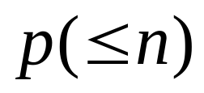
Abstract
Given an edge-weighted rooted tree T and a positive integer , where n is the number of vertices in T, we cover all vertices in T by a set of p subtrees each of which contains the root r of T. The minmax rooted-tree cover problem asks to find such a set of p subtrees so as to minimize the maximum weight of the subtrees in the set.

Slide 3
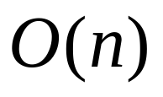

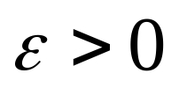
Abstract (cont.)
In this paper, we propose an time
(2+ ) - approximation algorithm to the problem,
where is a prescribed constant.

Slide 4
Minmax Rooted-Tree Cover Problem
(MRSC)
r
r

Slide 5
Minmax Rooted-Tree Cover Problem
(MRSC)
P=2
1
3
3
1
5
5
r
r
2
4
2
4
G
G
Max(8, 7)=8
Max(11, 4)=11

Slide 6

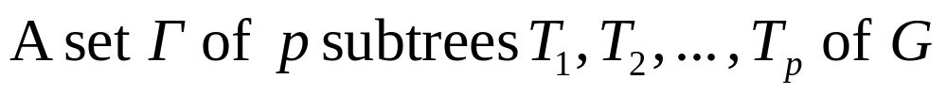

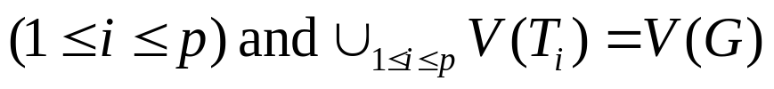
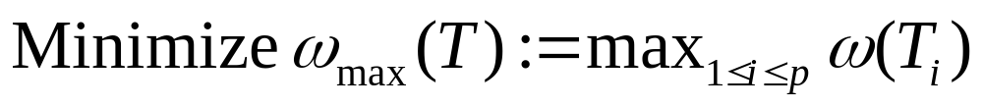
Minmax Rooted-Tree Cover Problem
(MRSC)
Input: An instance I = (G,w,p) which consists of a connected graph G with a designated vertex
called a root, an edge-weight w, and an integer
p ∈ [2,n], where n = |V (G)|.
Feasible solution:
such that
Goal:

Slide 7
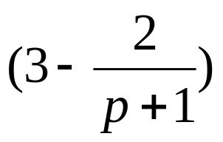
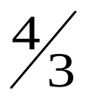
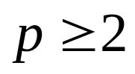
Minmax Rooted-Tree Cover Problem
(MRSC)
The MRSC is NP-hard even if G is a tree and p = 2
- approximation algorithm
In the case where G is a tree, a linear time
-approximation algorithm is known for p = 2.
In this paper, we propose a (2 + ε)-approximation algorithm to the MRSC with a tree G and , where ε > 0 is a prescribed constant.

Slide 8



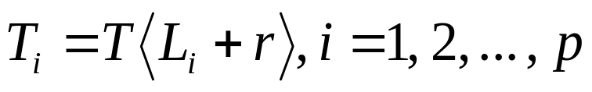

Reverse problem of the MRSC
We easily observe that any instance I = (T,w,p) of
the MRSC, where T is a tree, has an optimal solution
which is given by a p-partition
of L(T) in such a way that
each tree is obtained by
We treat a p-partition of L(T) as a solution to I = (T,w,p)

Slide 9

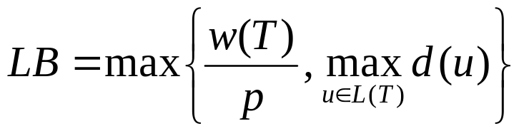
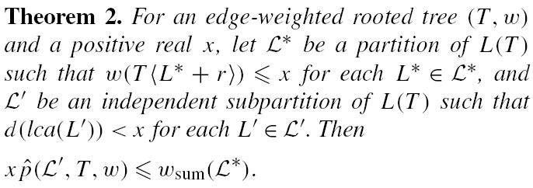

Lemma 1.
_

Slide 10
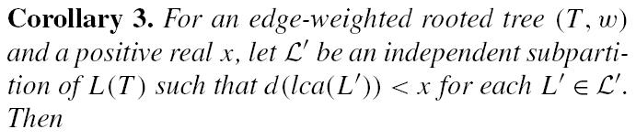

_

Slide 11
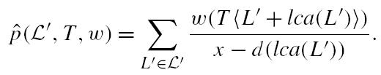

r
Independent
_

Slide 12
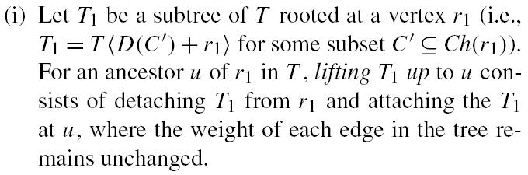


Two operations

Slide 13
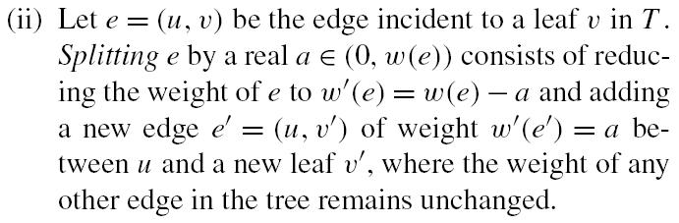

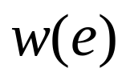



Two operations

Slide 14
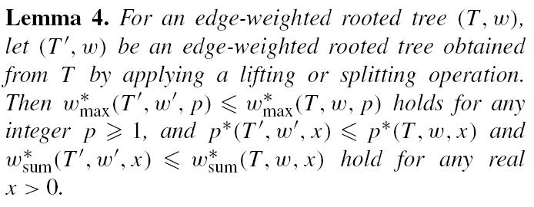

Slide 15
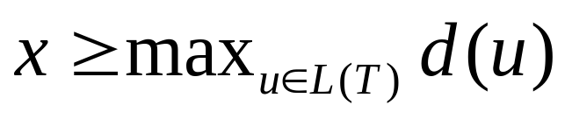


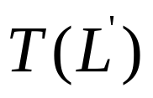
Algorithms for MRSC
Input: An edge-weighted rooted tree (T, w)
and a real
Output: A partition of L(T), a subtree
obtained by applying lifting and
splitting operations, and an
independent subpartition of

Slide 16
Algorithms for MRSC
X=20
r
5
3
6
3
3
8
1
9
12
9
8
4
1
1
3
3
2

Slide 17

Algorithms for MRSC
X=20
r
5
3
6
3
3
8
1
9
12
9
8
4
1
1
3
3
2

Slide 18
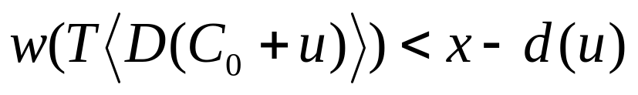
Algorithms for MRSC
X=20
r
5
3
6
3
3
8
1
9
12
9
8
4
6
4
3
3
2

Slide 19
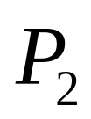

Algorithms for MRSC
X=20
r
5
3
6
3
3
1
9
9
8
2

Slide 20

Algorithms for MRSC
X=20
r
5
6
3
3
1
9
9
8
2

Slide 21
Algorithms for MRSC

Slide 22
Algorithms for MRSC

Slide 23
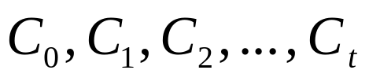
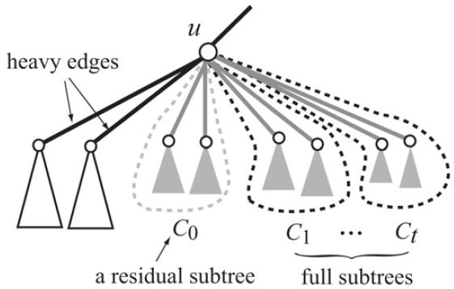
Heavy vertex
Partition the set of light children of u into
such that
and

Slide 24
Algorithms for MRSC
An edge e=(u, v) with v∈ Ch(u) is called heavy if v is heavy

Slide 25




Algorithms for MRSC

Slide 26

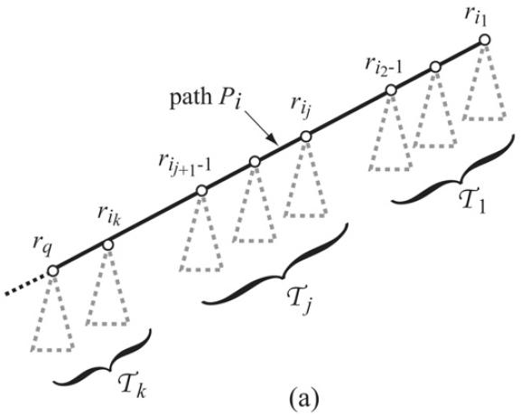
For each path

Slide 27
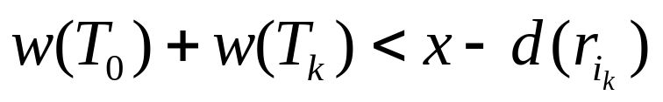
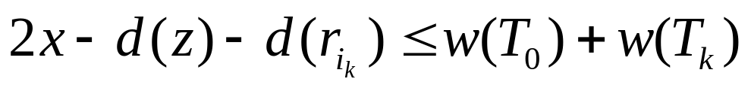
For each path
Case 1:
Case 2:
Case 3:

Slide 28
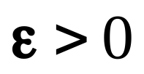

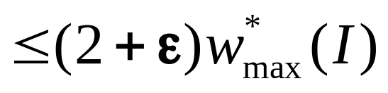
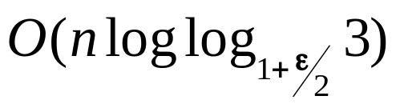
Theorem 7.
For a given instance I=(T, w, p) of the MRSC
and a specified , a p-partition of L(T)
satisfying ( ) can be found
in time.

